Slide 1







PROGRAMING FOR DATA SCIENCE
: What matters the most?
Miguel Lopes | Mª Helena Magro | Ana Ribeiro

Slide 2


AIRBNB: What matters the most?
Houses
Visitors
2016
2016
4.1 over-night average
718k
42,8M€ of income
66% [2015-2016]
Owner’s perspective
Customer’s perspective
With a specific ad which is the price per night?
Rating
Reviews
Notes:
1. After one year in Lisbon, airbnb had a visitors increase of 66% what corresponds a 718k visitors.
Most of us had already booked an apartment or a house on airbnb…it is the most used house rental online platform!
And what real matters when we are booking an apartment? The rating? the reviews? the pictures? We search for every detail but at end there is probably just 1 or 2 features that really matters. Who knows?
For us 3 it was an interesting question to answer!!!
This article aims to decipher which are the main features of a rental place in Lisbon that influence the most the price
per night in this region. Simultaneously, it also aims to reveal what the rental clients give more importance to.

Slide 3
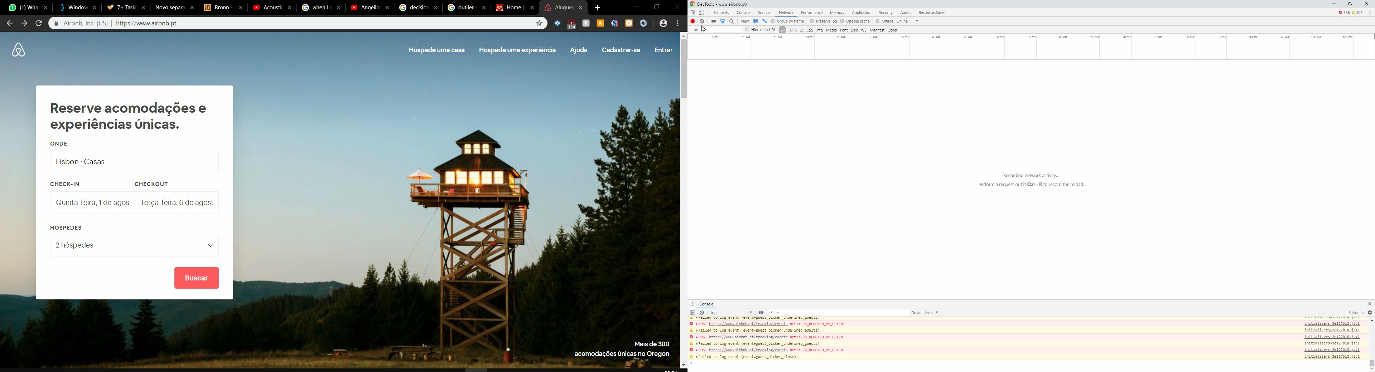
Data Extraction
Get the data
https://www.airbnb.pt/
https://www.airbnb.pt/s/Lisbon/homes
https://www.airbnb.pt/s/Lisbon/homes?checkin=2019-08-01&checkout=2019-08-06&adults=2
Notes:
First and foremost, get the data. We don't yet know what room parameters are important to get, so the main goal here is to get every information we can, for as many rooms as we can.
We all know the drill.
*CLICK*
Go to the website, find the url, *CLICK* , find the search path, (in this case, we are going to search for rooms in lisbon) *CLICK* adjust its parameters (is this case, a couple in the first week of august), get the HTML and get the relevant data.
Simple enough right?
*CLICK*

Slide 4
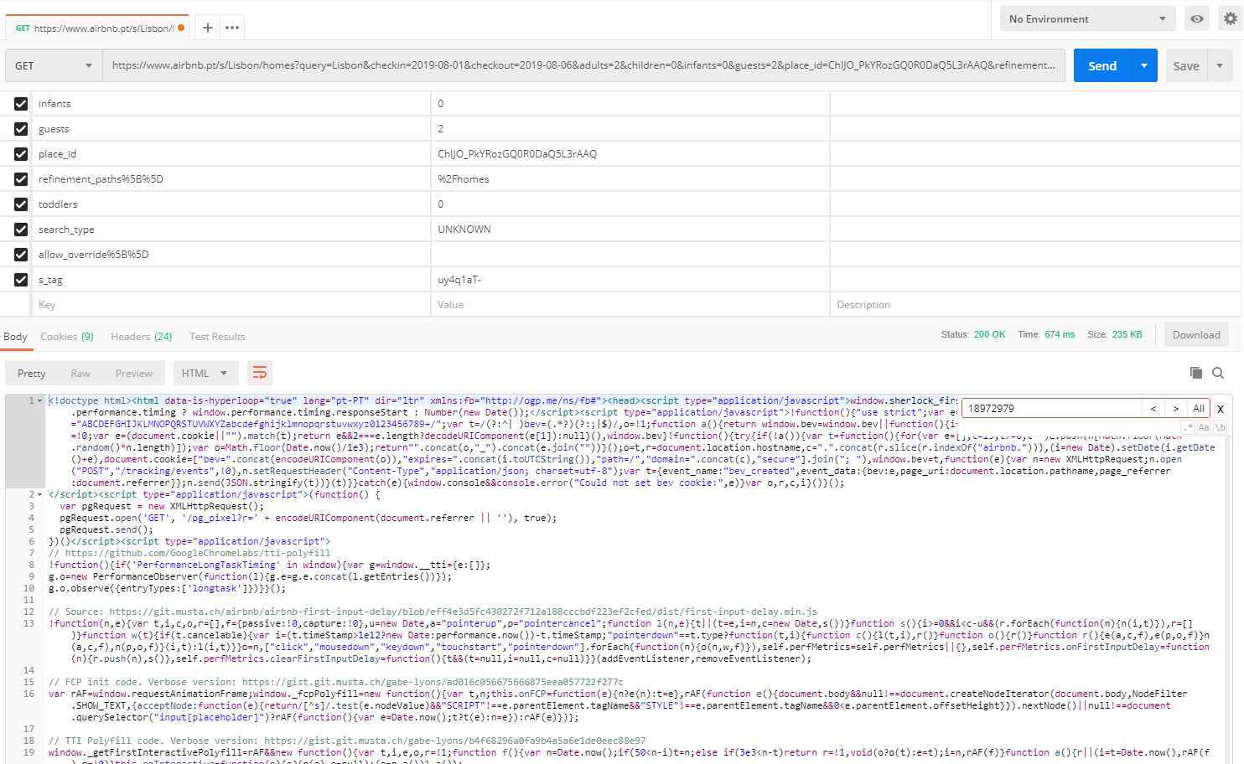
Data Extraction
Find Data
Not so fast!
Notes:
So we went to postman and did just that, an http get request. However, what we got, was not the HTML we were hoping for. If you look carefully at the response, you'll find that is only has script tags, with javascript only. *CLICK* Why can't reality be as simple as the exampels professor give in class??
What's worse, this response didn't have any information about the rooms at all, not the room ids, not the titles, nothing. *CLICK*

Slide 5

Data Extraction
Find Data
Not so fast!
Notes:
So we went to postman and did just that, an http get request. However, what we got, was not the HTML we were hoping for. If you look carefully at the response, you'll find that is only has script tags, with javascript only. *CLICK* Why can't reality be as simple as the examples professors give in class??
What's worse, this response didn't have any information about the rooms at all, not the room ids, not the titles, nothing. *CLICK*

Slide 6

Data Extraction
Finding information
100 requests
2.8MB
Notes:
So, on to some detective work. As you can see, when a request is performed on airbnb, what actually happens is a miryad of other requests in the background. And I mean, a lot of them. Hundreads. After searching inside each response, we ended up finding the relevant information in one of the requests, as a json response.

Slide 7
Data Extraction
'Oeiras, Lisboa, Portugal'
'Oeiras, Lisbon, Portugal'
'LISBOA, OEIRAS, Portugal'
Oeiras
Final Structure
Get Room Reviews
Search Postal Code
Search for rooms
Convert to DF and serialize
Room Object
Search Google Maps
RoomIDs: #10.400
Columns: #46
Notes:
This was just an exemple of the complexity we faced. In the end, we had to eprform many more requests.
Search for rooms gives a list of room ids. Then we loop though this list and perform a request to get the main data fo the room. This returns na html. Then we have to make a request to get just the reviews, since it’s not in the same page. *CLICK* After that, we make 2 additional requests to standardize the location strings and get the lisbon county.
So you can see here this dashed line represents a room, that was stored in a python class and then converted to a pandas dataframe. This dataframe is finally serialized to be used in the analysis

Slide 8

Preprocessing
Remove duplicated rooms
The search were done by county. The problem is that many of the rooms were overlapped – it was reduced from 10375 to 1996;

Slide 9
Preprocessing
Remove duplicated rooms
The search were done by county. The problem is that many of the rooms were overlapped – it was reduced from 10375 to 1996;
Delete NA, None or NULLS
More than 99% of the missing data was in the rating parameters – replace could compromise the results.

Slide 10
Preprocessing
Remove duplicated rooms
The search were done by county. The problem is that many of the rooms were overlapped – it was reduced from 10375 to 1996;
Delete NA, None or NULLS
More than 99% of the missing data was in the rating parameters – replace could compromise the results.
Deal with dates
Convert the two datetimes - last update of the room and date of creation of host account - to numerical values (months and days).

Slide 11
Preprocessing
Remove duplicated rooms
The search were done by county. The problem is that many of the rooms were overlapped – it was reduced from 10375 to 1996;
Delete NA, None or NULLS
More than 99% of the missing data was in the rating parameters – replace could compromise the results.
Deal with dates
Convert the two datetimes - last update of the room and date of creation of host account - to numerical values (months and days).
Deal with lists
The two lists - amenities and languages - transformed to a simply count of the number for each one.

Slide 12
Preprocessing
Remove duplicated rooms
The search were done by county. The problem is that many of the rooms were overlapped – it was reduced from 10375 to 1996;
Delete NA, None or NULLS
More than 99% of the missing data was in the rating parameters – replace could compromise the results.
Deal with dates
Convert the two datetimes - last update of the room and date of creation of host account - to numerical values (months and days).
Deal with lists
The two lists - amenities and languages - transformed to a simply count of the number for each one.
Delete redundant variables
The reviews are string variables - as an future investor does not know beforehand
Url has no information;
Minimum nights is a not a relevant
- 5 day occupancy rental.
4) Total price is the same as having rate per night multiplied by 5

Slide 13
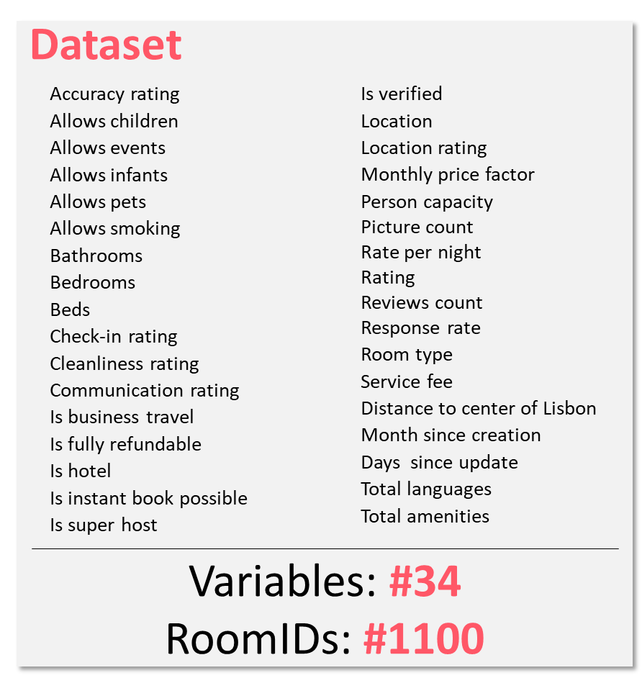
Preprocessing
Remove duplicated rooms
The search were done by county. The problem is that many of the rooms were overlapped – it was reduced from 10375 to 1996;
Delete NA, None or NULLS
More than 99% of the missing data was in the rating parameters – replace could compromise the results.
Deal with dates
Convert the two datetimes - last update of the room and date of creation of host account - to numerical values (months and days).
Deal with lists
The two lists - amenities and languages - transformed to a simply count of the number for each one.
Delete redundant variables
The reviews are string variables - as an future investor does not know beforehand
Url has no information;
Minimum nights is a not a relevant
- 5 day occupancy rental.
4) Total price is the same as having rate per night multiplied by 5

Slide 14
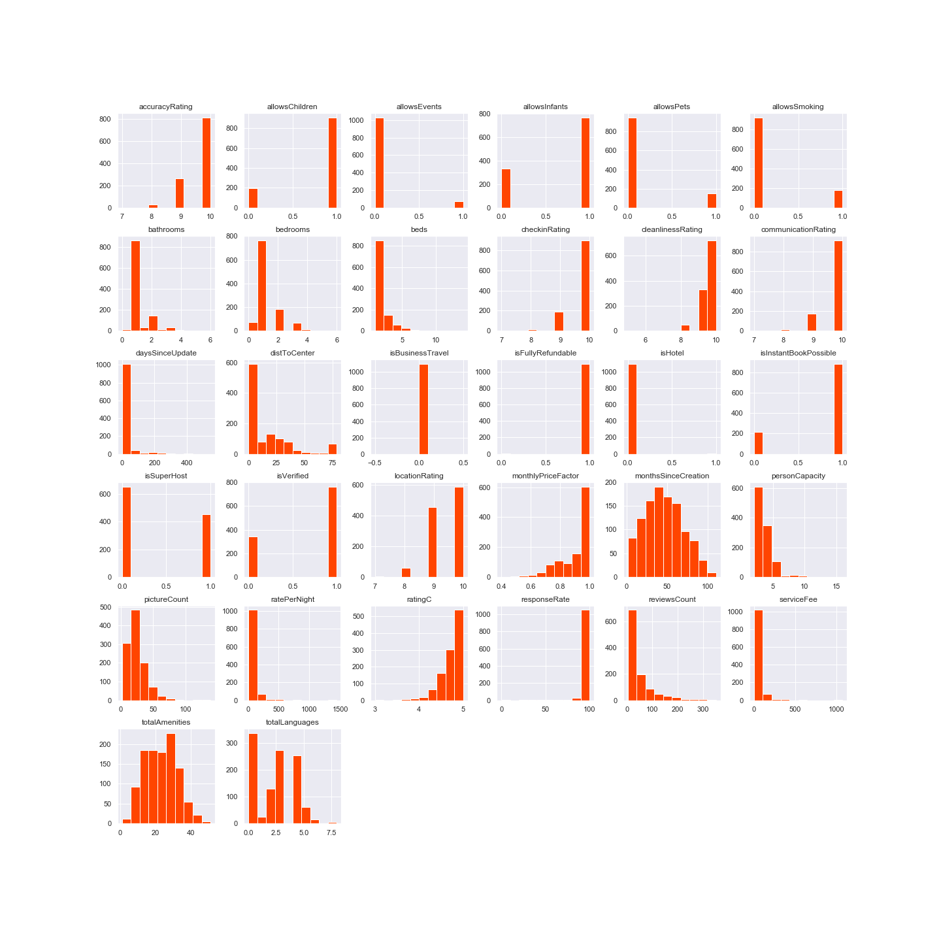

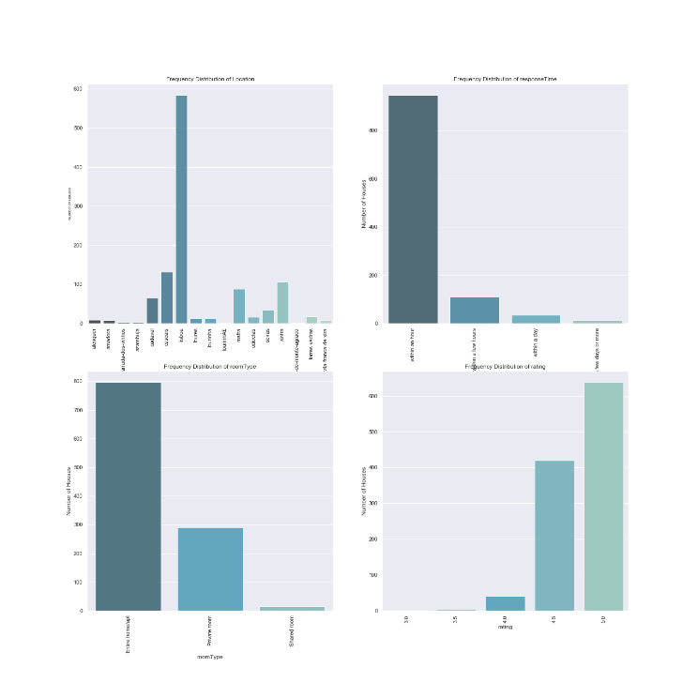
Descriptive Analysis
Dependent variable
Numerical variables
Categorical variables
Location
Rating
Response Time
Room Type.
ratePerNight, it reflects better the rental value
Notes:
Moving for the data for the predicting model:
The chosen dependent variable for this study is raterPerNight, as it reflects better the rental value:
The dataset was divided by numerical and categorical variables, and the histograms were plotted separately. The plot
visualization indicates that the majority of the variables are not normal distributed and have the data concentrated in
one or two classes. After that general observation, it was verified that there were not negative variables, and other inconsistent data. As an example, the sBusinessTravel and isFullyRefundable variables have all data in one class and
the isBusinessTarvel data is zero. These variables do not contribute to the predictive model and for that reason are
removed further in the analyze.
The categorical variables are fewer than numerical: location, rating, responseTime and roomType. As expected, in the
location histogram, Lisbon has the highest frequency followed by Cascais and Sintra. The most frequent room type is
entire home/ apartment followed by private room. About the rating, it is distributed essentially by rating 5 and 4.

Slide 15




Descriptive Analysis
Dependent variable
Numerical variables
Categorical variables
Location
Rating
Response Time
Room Type.
ratePerNight, it reflects better the rental value
Location
Time
Lisboa
Cascais
Sintra
Within an hour
Within a few hours
Room type
Rating
Apartment
Private room
4
5
Notes:
Moving for the data for the predicting model:
The chosen dependent variable for this study is raterPerNight, as it reflects better the rental value:
The dataset was divided by numerical and categorical variables, and the histograms were plotted separately. The plot
visualization indicates that the majority of the variables are not normal distributed and have the data concentrated in
one or two classes. After that general observation, it was verified that there were not negative variables, and other inconsistent data. As an example, the sBusinessTravel and isFullyRefundable variables have all data in one class and
the isBusinessTarvel data is zero. These variables do not contribute to the predictive model and for that reason are
removed further in the analyze.
The categorical variables are fewer than numerical: location, rating, responseTime and roomType. As expected, in the
location histogram, Lisbon has the highest frequency followed by Cascais and Sintra. The most frequent room type is
entire home/ apartment followed by private room. About the rating, it is distributed essentially by rating 5 and 4.

Slide 16



Feature selection
LISTING CHARACTERISTICS
HOUSE CHARACTERISTICS
HOST CHARACTERISTICS
RATING CHARACTERISTICS
Suitable for Business Travel?
Possibility for Instant Booking?
Months since creation
Fully Refundable?
# Reviews
Days since last uptade
Service Fee
Monthly Price Factor
# Pictures
# Bathrooms
# Bedrooms
# Beds
Person Capacity
Room Type
Distance to Lisbon Center
# Amenities
Is it a Hotel?
Location
Super Host?
Verified Host?
# Languages
Response Time
Location Rating
Rating
Accuracy Rating
Check-in Rating
Communication Rating
Cleanliness Rating
PERMISSIONS
Children
Events
Pets
Smoking
Infants

Slide 17
Feature selection
LISTING CHARACTERISTICS
HOUSE CHARACTERISTICS
HOST CHARACTERISTICS
RATING CHARACTERISTICS
Suitable for Business Travel?
Possibility for Instant Booking?
Months since creation
Fully Refundable?
# Reviews
Days since last uptade
Service Fee
Monthly Price Factor
# Pictures
# Bathrooms
# Bedrooms
# Beds
Person Capacity
Room Type
Distance to Lisbon Center
# Amenities
Is it a Hotel?
Location
Super Host?
Verified Host?
# Languages
Response Time
Location Rating
Rating
Accuracy Rating
Check-in Rating
Communication Rating
Cleanliness Rating
PERMISSIONS
Children
Events
Pets
Smoking
Infants
SelectKBest (Chi2);
Random Forest
Tree Classifier

Slide 18
Feature selection
LISTING CHARACTERISTICS
HOUSE CHARACTERISTICS
HOST CHARACTERISTICS
RATING CHARACTERISTICS
Suitable for Business Travel?
Possibility for Instant Booking?
Months since creation
Fully Refundable?
# Reviews
Days since last uptade
Service Fee
Monthly Price Factor
# Pictures
# Bathrooms
# Bedrooms
# Beds
Person Capacity
Room Type
Distance to Lisbon Center
# Amenities
Is it a Hotel?
Location
Super Host?
Verified Host?
# Languages
Response Time
Location Rating
Rating
Accuracy Rating
Check-in Rating
Communication Rating
Cleanliness Rating
PERMISSIONS
Children
Events
Pets
Smoking
Infants
SelectKBest (Chi2);
Random Forest
Tree Classifier
There were a total of 33 variables that could eventually explain the price of the rental per night. Applying the Features Selection, it was possible to reduce it to 8 numeric variables and 3 categorical

Slide 19
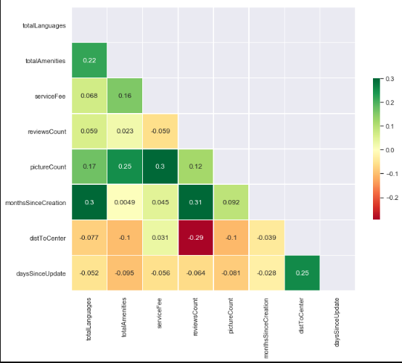
Validation and Outliers
MULTICOLINEARITY TEST

Slide 20
Validation and Outliers
MULTICOLINEARITY TEST
No significant correlation between the numeric variables (ρ < 0.6)

Slide 21
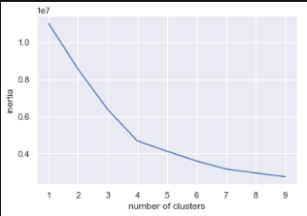
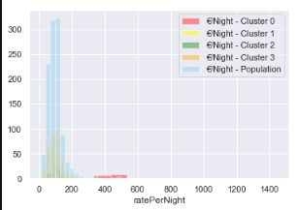
Validation and Outliers
MULTICOLINEARITY TEST
CLUSTERS CREATION
1. It was apllied the Kmeans model, in order to find the optimal number of cluster
No significant correlation between the numeric variables (ρ < 0.6)

Slide 22
Validation and Outliers
MULTICOLINEARITY TEST
CLUSTERS CREATION
1. It was apllied the Kmeans model, in order to find the optimal number of cluster
No significant correlation between the numeric variables (ρ < 0.6)
Creation of four clusters

Slide 23
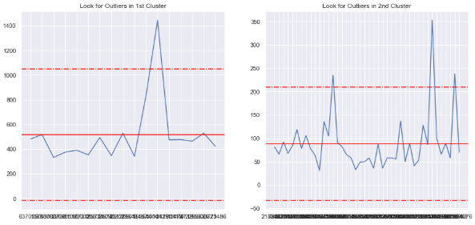
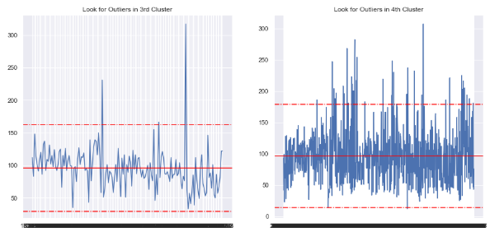
Validation and Outliers
MULTICOLINEARITY TEST
CLUSTERS CREATION
OUTLIERS REMOVAL
1. It was apllied the Kmeans model, in order to find the optimal number of cluster
No significant correlation between the numeric variables (ρ < 0.6)
Creation of four clusters

Slide 24
Validation and Outliers
MULTICOLINEARITY TEST
CLUSTERS CREATION
OUTLIERS REMOVAL
1. It was apllied the Kmeans model, in order to find the optimal number of cluster
No significant correlation between the numeric variables (ρ < 0.6)
Creation of four clusters
Consider only data that is in the interval
[μ – 2*σ; μ + 2*σ]

Slide 25
Predictive Model
Decision Tree Model
Random Forest Model
K-Nearest Neighbour Model

Slide 26
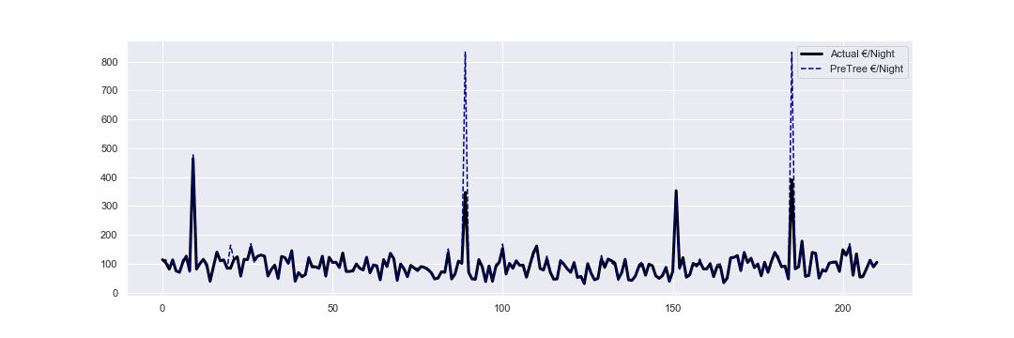
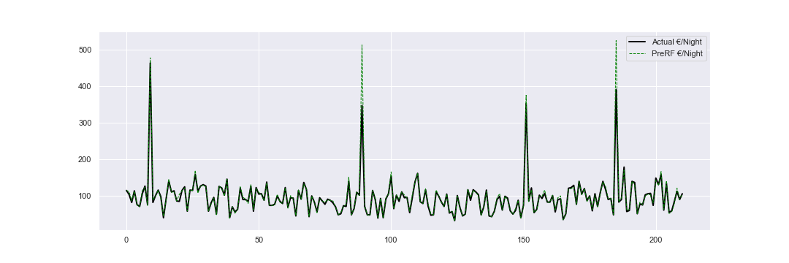
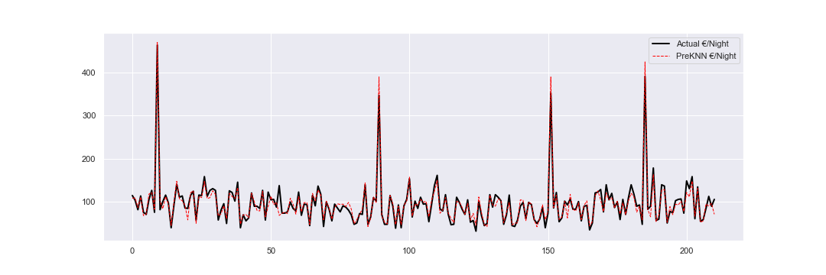
Predictive Model
Decision Tree Model
Random Forest Model
K-Nearest Neighbour Model

Slide 27
Predictive Model
Decision Tree Model
 | MSE_Test | MAE_Test | RMSE_Test | Score_Test
DecisionTree | 2097.75 | 7.61 | 45.80 | 0.18
RandomForest | 234.72 | 4.11 | 15.32 | 0.91
KNN | 138.48 | 8.22 | 11.77 | 0.95
Random Forest Model
K-Nearest Neighbour Model

Slide 28
Predictive Model
Decision Tree Model
 | MSE_Test | MAE_Test | RMSE_Test | Score_Test
DecisionTree | 2097.75 | 7.61 | 45.80 | 0.18
RandomForest | 234.72 | 4.11 | 15.32 | 0.91
KNN | 138.48 | 8.22 | 11.77 | 0.95
Random Forest Model
K-Nearest Neighbour Model

Slide 29
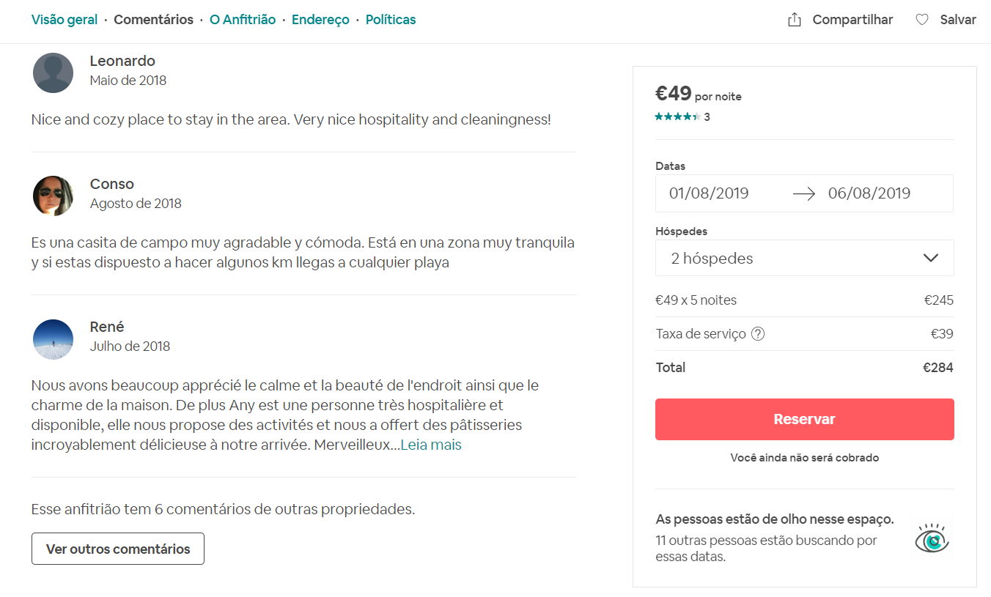
Reviews Analysis
Notes:
Our goal with this analysis is to go through all the reviews/comments for all the rooms and identify what Airbnb customers care the most about, when rating the rooms. Our main strategy is a very simple form of Natural Language Processing (NLP), in which we will correlate word frequencies with room ratings.
Before starting to analyze text data, we first need to go through some text pre-processing techniques. We should note here that this cleaning process could easily go on forever, since there's always an exception to every cleaning step. Therefore, our approach is to follow a minimum viable approach, with clear simple cleaning processes. Our goal is to get a “bag of words” for each room, i.e., a list of relevant words used in each room.
We proceeded with the following steps, by means of regular expressions:
The result is a string of words separated by a single space

Slide 30
Reviews Analysis
Regular Expressions
Merge
Lowercase
Only letters
Remove small words
['Amazing place very nice lady recommend to anywone',
'Lovely home situated in the quiet village of Labrugeria. Perfect for our needs and wonderful hosts. A great place to come home to after days out exploring all the lovely sites, beaches and towns of the area. 45 minutes by car to Lisbon and necessary for days out.']
Notes:
Our goal with this analysis is to go through all the reviews/comments for all the rooms and identify what Airbnb customers care the most about, when rating the rooms. Our main strategy is a very simple form of Natural Language Processing (NLP), in which we will correlate word frequencies with room ratings.
Before starting to analyze text data, we first need to go through some text pre-processing techniques. We should note here that this cleaning process could easily go on forever, since there's always an exception to every cleaning step. Therefore, our approach is to follow a minimum viable approach, with clear simple cleaning processes. Our goal is to get a “bag of words” for each room, i.e., a list of relevant words used in each room.
We proceeded with the following steps, by means of regular expressions:
The result is a string of words separated by a single space

Slide 31
Reviews Analysis
Regular Expressions
Merge
Lowercase
Only letters
Remove small words
['Amazing place very nice lady recommend to anywone',
'Lovely home situated in the quiet village of Labrugeria. Perfect for our needs and wonderful hosts. A great place to come home to after days out exploring all the lovely sites, beaches and towns of the area. 45 minutes by car to Lisbon and necessary for days out.']
"amazing place very nice lady recommend anywone lovely home situated the quiet village labrugeria perfect for our needs and wonderful hosts great place come home after days out exploring all the lovely sites beaches and towns the area minutes car lisbon and necessary for days out"
Notes:
We proceeded with the following steps, by means of regular expressions:
The result is a string of words separated by a single space

Slide 32
Reviews Analysis
Stop Words, foreign words, typos
"amazing place very nice lady recommend anywone lovely home situated the quiet village labrugeria perfect for our needs and wonderful hosts great place come home after days out exploring all the lovely sites beaches and towns the area minutes car lisbon and necessary for days out"
['amazing', 'place', 'nice', 'lady', 'recommend', 'lovely', 'home', 'situated', 'quiet', 'village', 'perfect', 'needs', 'wonderful', 'hosts', 'great', 'place', 'come', 'home', 'days', 'exploring', 'lovely', 'sites', 'beaches', 'towns', 'area', 'minutes', 'car', 'necessary', 'days']
Notes:
Next, we went through a slightly more advanced cleaning process. We used the library nltk which has a list of stopwords (very common words that bear no meaning) and a list of “all” English words. We then went through each string of words and converted it to a list of strings, splitting by space. Then we iterated over the list to remove all the stop words and words that don't exist in the English language, obtaining:
We can see that, for instance, “the” and “anywone” were removed because the first is a stop word and the latter is a typo.

Slide 33
Reviews Analysis
Grammatical Categorization
Keep Nouns and Adjectives
['amazing', 'place', 'nice', 'lady', 'recommend', 'lovely', 'home', 'situated', 'quiet', 'village', 'perfect', 'needs', 'wonderful', 'hosts‘, 'great', 'place', 'come', 'home', 'days', 'exploring', 'lovely', 'sites', 'beaches', 'towns', 'area', 'minutes', 'car', 'necessary', 'days']
['amazing', 'place', 'nice', 'lady', 'home', 'quiet', 'village', 'perfect', 'wonderful', 'great', 'place', 'home', 'days', 'sites', 'beaches', 'towns', 'area', 'minutes', 'car', 'necessary', 'days']
Notes:
Afterwards, we used nltk once again to categorize each word according to its grammatical class. We decided that the words that port value to our analysis are only nouns and adjectives. Keeping only those resulted in:
Here we can see that “recommend” and “situated” were removed, due to being verbs. “lovely”, for instance, was identified as an adverb, although in this case it really is an adjective. Overall, after manually analyzing many of the thousand comments, we can say that this step was not very successful, misidentifying some words grammatically. Nonetheless, it was still better to perform this cleaning method than otherwise.

Slide 34
Reviews Analysis
Stemmatization
['amazing', 'place', 'nice', 'lady', 'home', 'quiet', 'village', 'perfect', 'wonderful', 'great', 'place', 'home', 'days', 'sites', 'beaches', 'towns', 'area', 'minutes', 'car', 'necessary', 'days']
['amazing', 'place', 'nice', 'lady', 'home', 'quiet', 'village', 'perfect', 'wonder', 'great', 'place', 'home', 'day', 'site', 'beach', 'town', 'area', 'minute', 'car', 'necessary', 'day']
Notes:
Then, we again used nltk to stemmatize words, i.e., convert every word to its most elementary stem. For instance, communication stems to commun. However, since these stems are not English words and are difficult to read, we substituted them, for simplicity, by the first word that was stemmatized to the same stem.
In this case, “days” was converted to “day”, and thus we decreased the number of words without losing information.

Slide 35
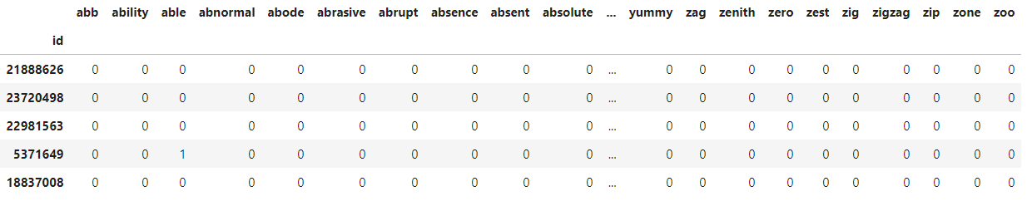
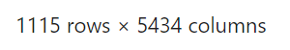
Reviews Analysis
Matrix term
“Bag of Words” -> Matrix of word frequencies, by room
Notes:
By using sklearn, we converted the “bag of words” format to a matrix where we have the rooms in the the rows and every word in the columns. The value is the frequency of the word for that room:

Slide 36
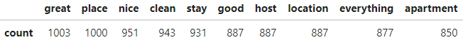
Reviews Analysis
Most common words
Most common words != Most relevant words
Most correlated words with rating
Notes:
With this matrix, we can easily find the most common words:
However, this does not tell us much. A word that is used in every comment, effectively has no added value.
Therefore, we decided to filter out the words that appear too many times (>80%) or too few times (<20%) and, for the remaining, find the correlation between each word and the rating of the room. After removing some words that give no insights (eg: beautiful, great, amazing, etc), we generated the following wordcloud, with the top correlated words:

Slide 37
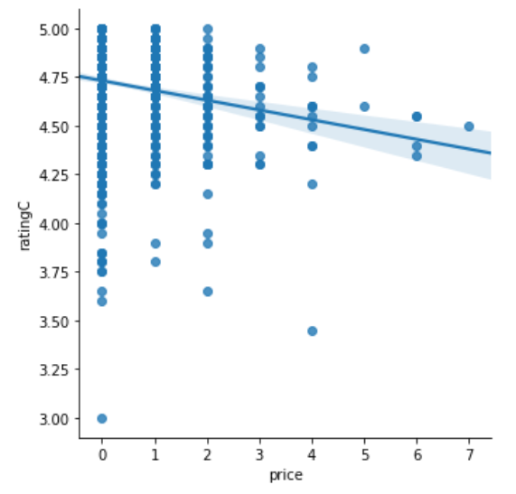
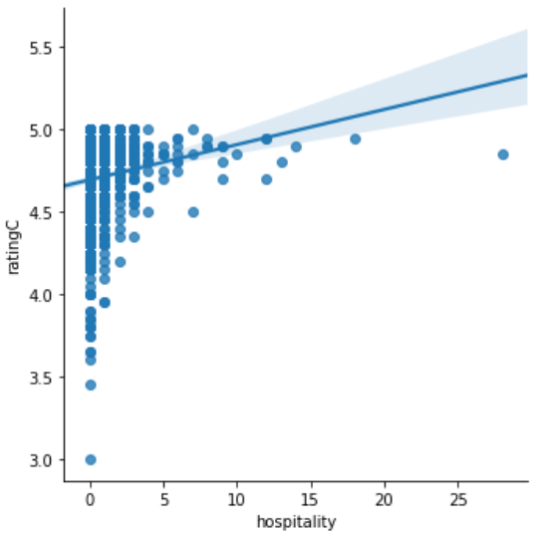
Reviews Analysis
Highest correlated words with rating
Notes:
Therefore, we decided to filter out the words that appear too many times (>80%) or too few times (<20%) and, for the remaining, find the correlation between each word and the rating of the room. After removing some words that give no insights (eg: beautiful, great, amazing, etc), we generated the following wordcloud, with the top correlated words:

Slide 38
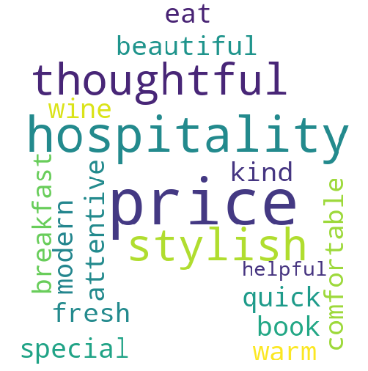
Reviews Analysis
Highest correlated words with rating
Host: Hospitality, Thoughtful, Attentive, Kind, Helpful
Food: Eat, Wine, Breakfast
Room Feel: Confortable, Warm, Fresh
Room Style: Beautiful, Modern, Stylish

Slide 39








Conclusion
Top 5 features
Top 3 words
The house has:
#Amenities
PRICE
15 amenities
2 languages
20€ in Service Fee
No reviews (since it is new)
10 pictures
1km from the centre
0 months on airbnb
1 day since update
Location at Arruda-dos-vinhos
#Languages
HOSPITALITY
Service Fee per stay
#Reviews
FOOD
#Pictures
99,7 €
Customer’s perspective
Ower’s perspective
Notes:
An investor that creates an ad that offers 15 amenities, charges 20€ in Service Fee, has no reviews (since
it is new), it has 10 pics, and it is located 1km from the center ([{'totalLanguages': 2, 'totalAmenities': 15, 'serviceFee':
20, 'reviewsCount': 0, 'pictureCount': 10, 'monthsSinceCreation':0, 'distToCenter':1, 'daysSinceUpdate':1, 'respTime':1
,'room':2, 'loc':2 (arruda-dos-vinhos)}]) can charge 99,7€ per night

